Slide 1
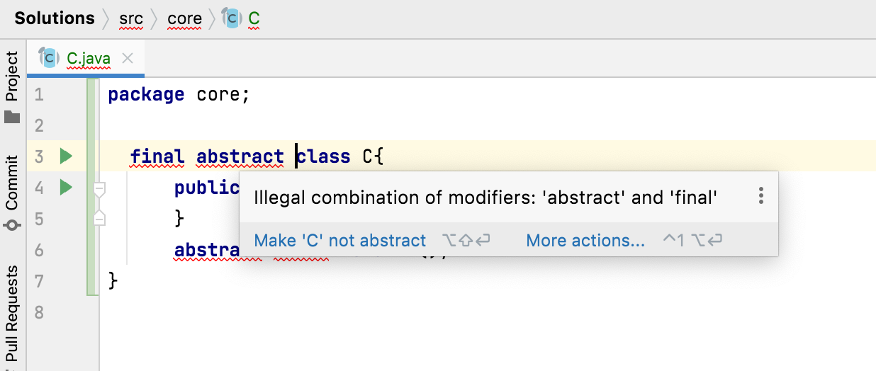
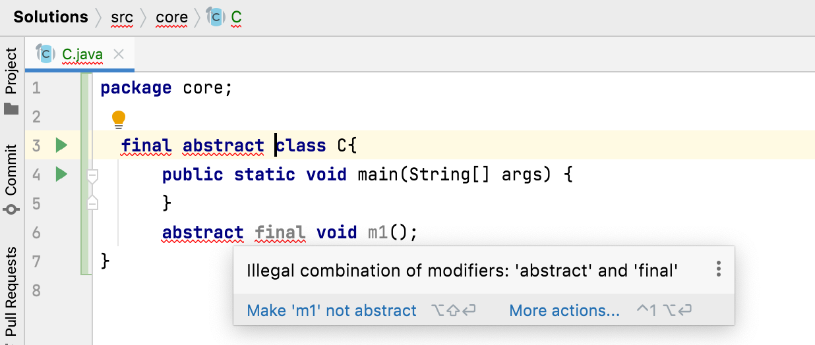
Why final and abstract can not be used at a time?
final and abstract are totally opposite in nature.
final → a class or method does not need further improvements.
abstract → a class or method needs further improvements.

Slide 2
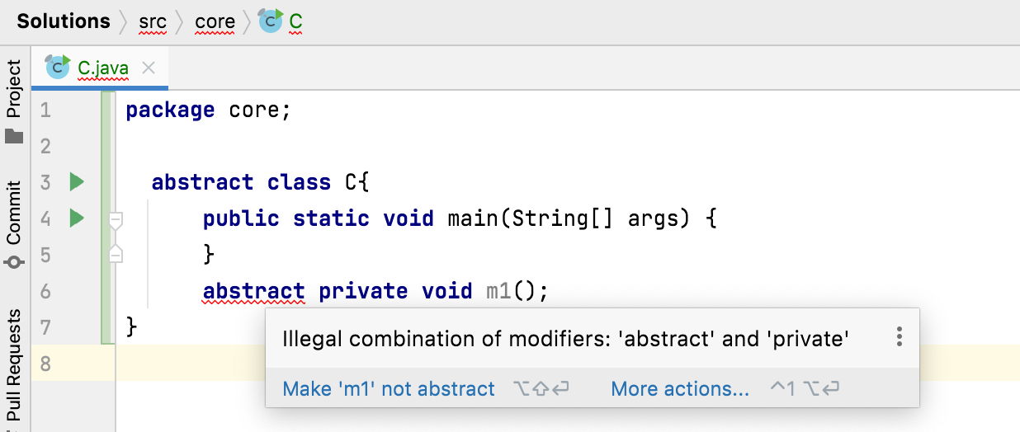
Can we declare abstract methods as private?
No. Abstract methods can not be private.
If abstract methods are allowed to be private, then they will not be inherited to sub class and will not get enhanced.

Slide 3
All these combinations are illegal.
synchronized
static
private
final
Abstract
native
strictfp

